Slide 1

Distributed transactions and two-phase commit protocol
Database Management System | Transaction Management and Scheduling
Course: Database Management System | Chapter: Transaction Management and Scheduling | Program: B.TECH-CSE, B.TECH CSE - CYBER SECURITY, B.TECH CSE - DATA
DISCOVER · LEARN · EMPOWER
Notes:
Welcome everyone to today's lecture on Distributed Transactions. We are diving deep into how databases handle transactions across multiple sites. This is a critical topic for ensuring data consistency in modern distributed systems. Remember, our motto at Chandigarh University is to Discover, Learn, and Empower.

Slide 2
Course Outcomes
SLIDE 2 / 14
Course Outcome
CO | BT LEVEL | DESCRIPTION
CO1 | BT2 | Explain database architecture, relational model concepts and formal query language foundations including relational algebra and relational calculus.
CO2 | BT3 | Apply relational algebra, relational calculus and SQL constructs to formulate correct and efficient database queries.
CO3 | BT4 | Analyze functional dependencies and design normalized relational schemas up to 5NF ensuring lossless join and dependency preservation.
CO4 | BT4 | Analyze transaction schedules and concurrency control mechanisms to determine serializability, recoverability and correctness.
CO5 | BT5 | Evaluate storage structures, indexing strategies and query optimization techniques for performance, scalability and reliability.
Chandigarh University
2 / 14
Notes:
Today's lecture directly addresses our Course Outcomes. CO1 is covered as we explain the architecture of distributed databases. CO5 is addressed when we evaluate the reliability and scalability of the Two-Phase Commit protocol. These outcomes ensure you understand both the theory and the practical performance implications.

Slide 3
Learning Objectives
SLIDE 3 / 14
Learning Outcomes
1
Define a distributed transaction and its scope across multiple sites.
2
Explain the necessity of atomicity in a distributed environment.
3
Describe the two phases of the Two-Phase Commit protocol.
4
Analyze the role of the coordinator and participant nodes.
5
Identify common pitfalls like blocking states and network failures.
Chandigarh University
3 / 14
Notes:
By the end of this session, you will be able to define a distributed transaction clearly. You will understand why atomicity is harder to achieve when data is spread out. We will walk through the commit protocol step-by-step. Finally, we will discuss what happens when things go wrong in a network.

Slide 4
Lecture
SLIDE 4 / 14
Distributed Transaction Definition
THE TRANSACTION IS ATOMIC
it either commits everywhere or aborts everywhere.
• A distributed transaction spans multiple database sites or nodes.
• It must satisfy ACID properties across all participating sites.
• Local transactions affect only one site, while distributed ones affect many.
• Consistency requires that all sites agree on the final state.
Chandigarh University
4 / 14
Notes:
Think of a distributed transaction as a single logical unit of work. It might update a bank account in Delhi and a ledger in Mumbai simultaneously. If the update in Delhi succeeds but Mumbai fails, the whole transaction must roll back. This ensures the bank balance remains consistent across the entire network.

Slide 5
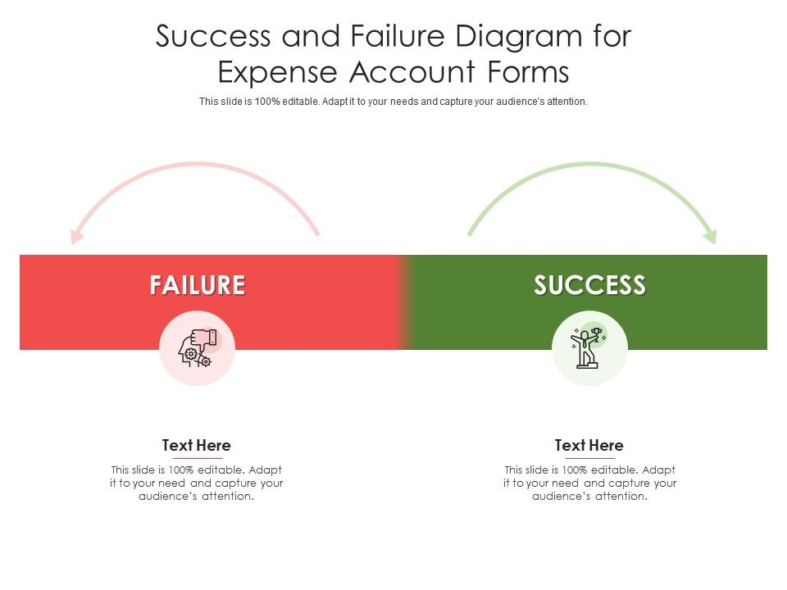
Lecture
SLIDE 5 / 14
The Atomicity Challenge
1
Network failures can cause partial updates across different sites.
2
A site might commit locally while the coordinator is unaware.
3
Without a protocol, the system enters an inconsistent state.
4
The goal is to ensure all sites vote and decide together.
5
Atomicity prevents data loss or duplication in distributed environments.
Source: www.slideteam.net
Chandigarh University
5 / 14
Notes:
The biggest challenge here is the network. Imagine a message gets lost between the coordinator and a participant. That participant might think the transaction failed and roll back, while the coordinator thinks it succeeded. This leads to data inconsistency. We need a protocol to prevent this specific scenario.

Slide 6
Lecture
SLIDE 6 / 14
Two-Phase Commit Overview
1
The protocol ensures all sites agree before any commit occurs.
2
It involves a Coordinator and multiple Participant nodes.
3
Phase 1 is the Voting Phase where participants prepare.
4
Phase 2 is the Decision Phase where the final outcome is broadcast.
5
No site commits until the Coordinator sends a global commit.
Chandigarh University
6 / 14
Notes:
The Two-Phase Commit protocol is the standard solution for this problem. It works in two distinct stages. First, everyone prepares to commit. Second, everyone decides to commit or abort. This two-step process guarantees that no one commits unless everyone is ready.

Slide 7
Phase 1
SLIDE 7 / 14
Voting Phase
1
Coordinator sends a 'Prepare' message to all participant nodes.
2
Each participant executes the transaction locally up to the point of commit.
3
Participants write a 'Prepare' log record to ensure durability.
4
Participants vote 'Yes' if ready or 'No' if they cannot commit.
5
A 'No' vote immediately triggers a global abort decision.
Chandigarh University
7 / 14
Notes:
In the first phase, the coordinator asks everyone, 'Are you ready to commit?'. Each participant tries to do the work and logs it. If a participant encounters an error, it votes 'No'. If even one person says 'No', the whole transaction is doomed. This prevents partial execution.

Slide 8
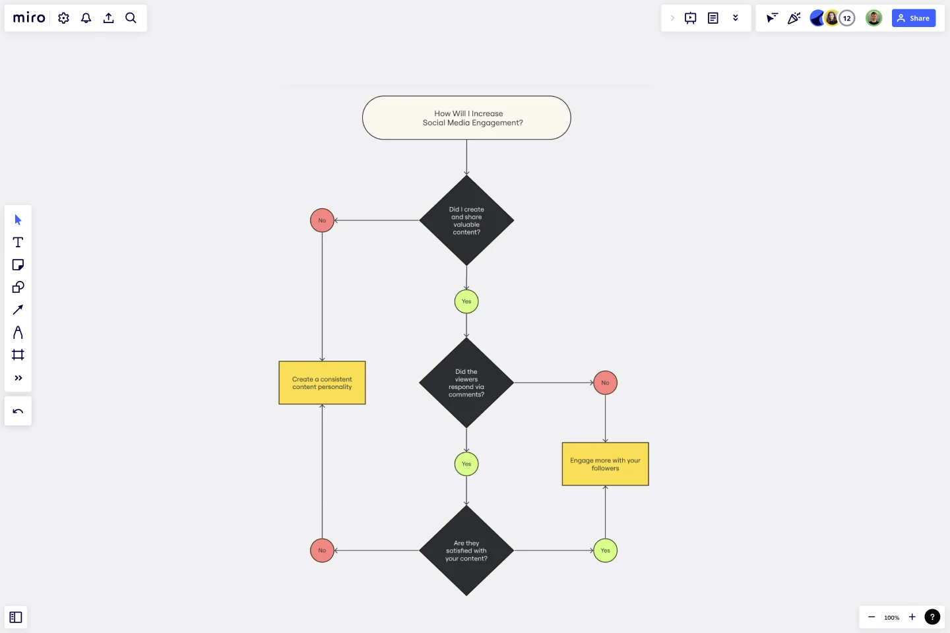
Phase 2
SLIDE 8 / 14
Decision Phase
1
Coordinator waits for votes from all participants.
2
If all votes are 'Yes', Coordinator decides to 'Commit'.
3
If any vote is 'No', Coordinator decides to 'Abort'.
4
Coordinator sends the decision to all participants.
5
Participants execute the decision and release locks.
Source: images.ctfassets.net
Chandigarh University
8 / 14
Notes:
Once the coordinator has all the votes, it makes the final call. If everyone said yes, it sends a 'Commit' command. If anyone said no, it sends an 'Abort' command. This ensures that the decision is global. Participants then finalize the transaction and free up their resources.

Slide 9
Lecture
SLIDE 9 / 14
Worked Numerical Example
SCENARIO
Transfer 100 units from Site A to Site B.
• Coordinator sends 'Prepare' to Site A and Site B.
• Site A logs 'Prepare' and votes 'Yes' (sufficient funds).
• Site B logs 'Prepare' and votes 'Yes' (space available).
• Coordinator receives two 'Yes' votes and sends 'Commit'.
Chandigarh University
9 / 14
Notes:
Let's look at a concrete example. We want to transfer 100 units. The coordinator asks Site A and Site B to prepare. Both sites check their resources and log the preparation. Since both vote yes, the coordinator sends the commit command. Both sites then update their balances permanently.

Slide 10
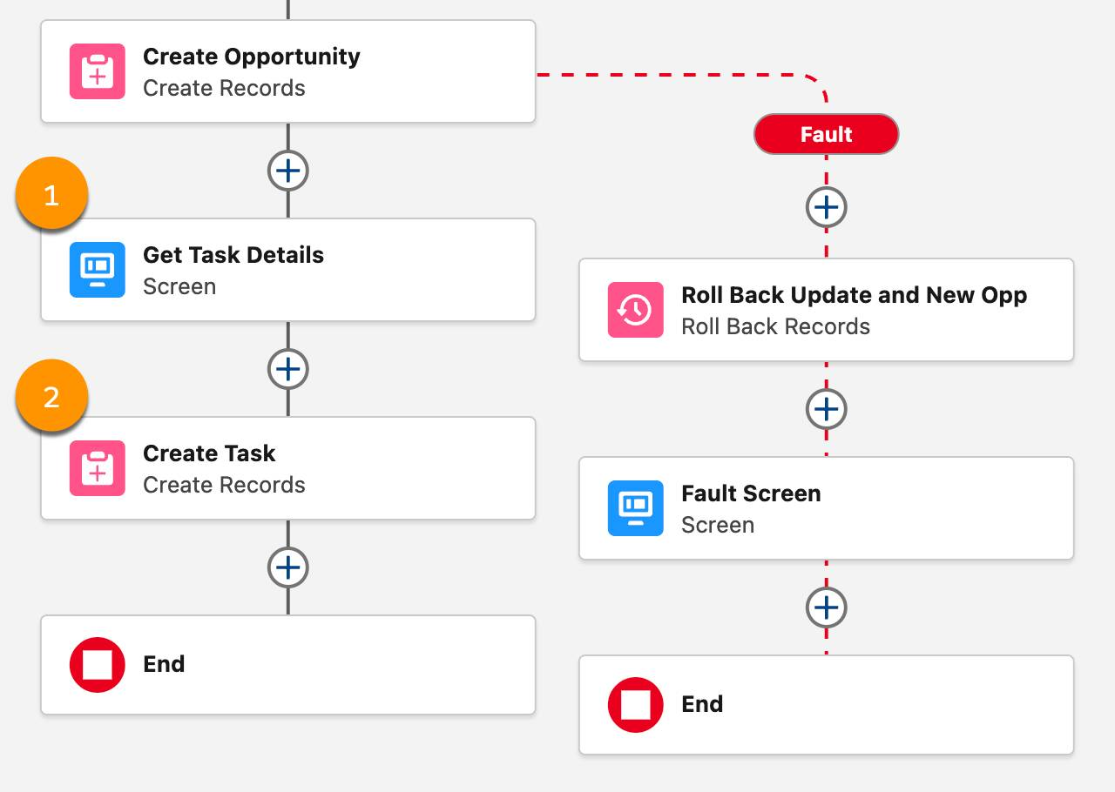
Lecture
SLIDE 10 / 14
Worked Numerical Example (Failure)
SCENARIO
Transfer 100 units from Site A to Site B.
• Site A votes 'Yes' but Site B votes 'No' (insufficient space).
• Coordinator receives one 'Yes' and one 'No' vote.
• Coordinator decides to 'Abort' the transaction globally.
• Both sites roll back their local changes to initial state.
Source: res.cloudinary.com
Chandigarh University
10 / 14
Notes:
Now consider a failure. Site A is ready, but Site B runs out of space. Site B votes 'No'. The coordinator sees this and immediately decides to abort. Even though Site A was ready, it must also roll back. This ensures the data remains consistent across both sites.

Slide 11
Common Pitfalls
SLIDE 11 / 14
Blocking
1
Participants block if they wait for the Coordinator's decision.
2
If the Coordinator crashes, participants cannot proceed or abort.
3
This creates a 'blocking' state where resources are held indefinitely.
4
Participants must wait until the Coordinator recovers or × out.
5
Blocking reduces system availability and throughput significantly.
Chandigarh University
11 / 14
Notes:
A major pitfall is the blocking problem. If the coordinator crashes after receiving all votes but before sending the decision, participants are stuck. They cannot commit because they don't have the final order, and they cannot abort because they don't know if others committed. They must wait, holding onto resources.

Slide 12
Common Pitfalls
SLIDE 12 / 14
Network Failures
1
Lost 'Prepare' messages cause participants to timeout and abort.
2
Lost 'Commit' messages leave participants in an uncertain state.
3
Participants must log their state to recover after network issues.
4
Recovery protocols are needed to resolve the uncertainty.
5
Network partitions can split the cluster into isolated groups.
Chandigarh University
12 / 14
Notes:
Network failures are another common issue. If a 'Commit' message is lost, a participant might not know if it should commit or abort. It relies on its logs to recover later. If the network splits, different parts of the system might make different decisions, leading to inconsistency. Robust logging is essential here.

Slide 13
Lecture
SLIDE 13 / 14
Key Takeaways
1
Distributed transactions require atomicity across multiple independent sites.
2
Two-Phase Commit ensures all sites agree before committing.
3
Phase 1 collects votes; Phase 2 broadcasts the final decision.
4
Blocking occurs if the coordinator fails during the decision phase.
5
Robust logging is essential for recovery from network failures.
Chandigarh University
13 / 14
Notes:
To summarize, distributed transactions are complex but necessary for modern systems. The Two-Phase Commit protocol is the standard way to handle them. Remember the two phases: voting and decision. Be aware of the blocking problem and the need for logging. These concepts are vital for your understanding of database reliability.

Slide 14
Lecture
SLIDE 14 / 14
References
1
Fundamentals of Database Systems — Ramez Elmasri & Shamkant B. Navathe
2
Database System Concepts — Silberschatz, Korth & Sudarshan
3
Database Management Systems — Raghu Ramakrishnan & Johannes Gehrke
4
Oracle/MySQL Documentation — Oracle
Chandigarh University
14 / 14
Notes:
For further reading, please refer to the standard textbooks listed here. Elmasri and Navathe provide excellent theoretical foundations. Silberschatz offers a comprehensive view of system concepts. Ramakrishnan and the Oracle documentation provide practical insights. Thank you for your attention today.

